Slide 1

AI-Enhanced Climate Smart Farming: Towards Empowering African Women Farmers by Prof. Dr. Olanike F. Deji, Department of Agricultural Extension and Rural Development, Faculty of Agriculture, Obafemi Awolowo University, Ile Ife, Osun State, Nigeria. E-mail: odeji@oauife.edu.ng @ Artificial Intelligence for Women in Agriculture (AI4WIA) Conference, 24th October 2023, Kwara State University, Malete, Nigeria.

Slide 2
Presentation outlines
Women Farmers roles in African Agriculture
Challenges facing women farmers in Africa
Efforts at addressing the challenges facing the women farmers
Effects of Climate Change on Women Farmers
Climate Smart Farming (CSF)
Contributions of AI-Enhanced CSF to empowering African women farmers
Gender responsive strategies for integrating AI-Enhanced CSF into African Agriculture
Examples of AI-Enhanced CSF in Africa

Slide 3
Women Farmers roles in African Agriculture
Food Production
Livestock Farming
Seed Saving and Preservation
Post-Harvest Processing
Water Management
Community Building
Income Generation
Nutrition and Household Well-being
Environmental Stewardship
Rural Education
Resilience Building
Innovations in Agriculture

Slide 4
Challenges facing women farmers in Africa
Limited Access to Land
Limited Access to Resources
Inadequate Training and Extension Services
Time and Labour Intensive Farming
Post-Harvest Losses
Lack of Market Access
Gender-Based Violence
Climate Change Vulnerability
Lack of Legal Rights
Healthcare Access
Inadequate Representation
Illiteracy and Lack of Information
Cultural and Social Norms

Slide 5
Domain | Indicators | Men (%) | Women (%)
Contribution to Production and Agro-processing | Agricultural production (ACTION AID, 2009) Agricultural processing (ACTION AID, 2009) Animal Husbandry (ACTION AID, 2009) | 30 40 50 | 70 60 50
Access to Resources | Ownership of land (DFID, 2012) Access to agricultural loan (FMARD, 2016) Access to capital from financial services (DFID, 2012) Ownership of bank account (DFID, 2012) | 93 70 99 85 | 07 30 01 15
Access to Services | Share among extension workers (DFID, 2012) Farmer registration | 94 90 | 06 10
Source: | FMARD, 2016

Slide 6
Efforts at addressing the challenges facing the women farmers
Gender-Sensitive Agricultural Policies
Access to Credit
Agricultural Extension Services
Rural Infrastructure Development
Market Access and Value Chain Development
Climate-Smart Agriculture
Empowerment and Capacity Building
Healthcare and Family Planning Services
Legal and Policy Reforms
Awareness and Advocacy
Education and Literacy
Technology Adoption
Research and Data Collection

Slide 7
Effects of Climate Change on Women Farmers
Erratic Weather Patterns
Reduced Crop Yields
Water Scarcity
Livestock Health
Increased Workload
Food Insecurity
Displacement and Migration
Health Risks
Economic Vulnerability
Limited Decision-Making Power

Slide 8
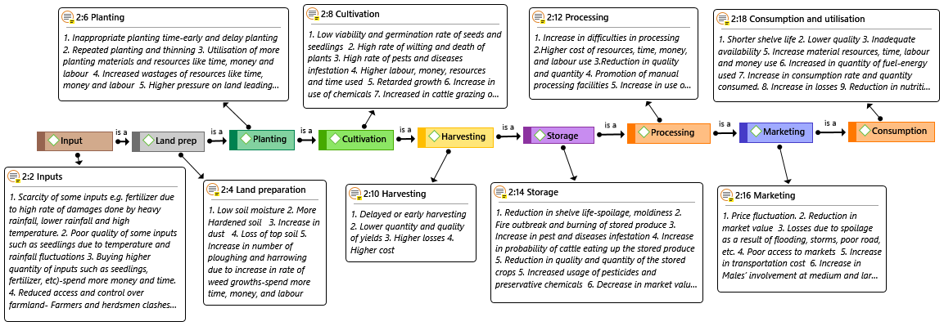
Climate Change Impacts along AVC:

Slide 9
What is Climate Smart Farming (CSF)?
An approach to agricultural practices that aims to address the challenges posed by climate change while promoting sustainable and productive farming systems.
It involves the integration of three main objectives:
Adaptation to Climate Change
Mitigation of Climate Change
Improving Productivity and Food Security

Slide 10
Key components and practices associated with climate-smart farming (CSF)?
Diversification
Conservation Agriculture
Water Management
Agroforestry
Use of Climate-Resilient Crop Varieties
Sustainable Livestock Management
Farm-Level Diversification
Data and Technology

Slide 11
Contributions of AI-Enhanced CSF to empowering African women farmers
Access to Climate Information
Crop Management
Market Access
Pest and Disease Control
Water Management
Access to Information
Financial Inclusion
Reducing Drudgery
Data Collection and Analysis
Empowering Women's Decision-Making
Support for Women's Networks
Capacity Building
Sustainable Practices
Women's Ownership and Land Rights

Slide 12
Gender responsive strategies for integrating AI-Enhanced CSF into African Agriculture
Gender-Inclusive Design
Local Language and Literacy
Training and Capacity Building
Awareness and Education
Accessible and Affordable Technology
Local Ownership and Control
Gender-Disaggregated Data Collection
Customization and Personalization
Financial Inclusion
Community Engagement
Collaboration and Partnerships
Legal Rights and Land Tenure
Health and Safety
Measuring Impact
Support Networks and Cooperatives
Sensitivity to Cultural Norms

Slide 13
Examples of AI-Enhanced CSF in Africa
AI-Enhanced Weather Forecasting
Crop Monitoring and Disease Detection
Precision Agriculture
Digital Advisory Services
Market Access and Price Information
Smart Irrigation Systems
Livestock Management
Drones for Farming
Mobile Banking and Financial Services
AgTech Platforms
Remote Sensing for Climate Data
Climate-Resilient Crop Varieties
Blockchain for Supply Chain Management
Voice-Based Technologies
Data Analytics and Insights
AI-Driven Insurance
E-Learning and Training

Slide 14
Conclusions
Several AI-climate smart technologies are being used in African agriculture to enhance productivity, sustainability, and resilience in the face of climate change.
These AI-climate smart technologies are contributing to improving agricultural practices, increasing resilience, and empowering farmers, including women, across Africa.
It's essential to continue developing and adopting these technologies using socio-technical methodology that could produce responsible AI-Enhanced CS technologies that are accessible and beneficial to all farmers, especially smallholders and marginalized women farmers in Africa.

Slide 15
The End
Thank you for your attention!
Vielen Dank!

